Slide 1
More About Research and Beliefs
Interpretive Frameworks

Slide 2
Notes:
Four arrows.
Well, this is something quite different if you graduated from Michigan State.
Notice how you can see the arrows or see the M but not both at the same time. Our minds sort information in predictable ways. That sorting is often based on interest (what is important). If an interest is strong enough that will keep us from seeing things in other ways.

Slide 3
Research
In research we are always making decisions about what we see.
That means, because of those decisions, there are things we will not see.
That means that research results will ALWAYS be biased by the choices you make.
Part of a researcher’s job is to make that bias as obvious as possible.

Slide 4
Subjectivity
The perceptions, experiences, expectations, personal or cultural understanding, and beliefs specific to a person that influence and inform an individual’s judgments about truth or reality.

Slide 5
Positionality
I see what I am disposed to see.
When I see something it means that I do not see other things. (figure/ground)

Slide 6
The Influence of Positionality
Research design
Data gathering
Analysis

Slide 7
Reflexivity
Since study design, data collection, and analysis are to some extent a product of the researcher’s positionality, it is crucial to research that a researcher makes the influences on subjectivity as apparent as possible.

Slide 8
Reflexivity
In quantitative research we do this by eliminating as many influences of the researcher as possible.
Attention to validity and reliability usually presented in the methods section
In qualitative research we do this by including rigorous self-reflection on the research process in the final report.
It can be anywhere in the report

Slide 9
Validity
When is research valid?

Slide 10
Validity
Research is valid when it is an accurate and generalizable description of the phenomenon being investigated.
Generalizable beyond the study sample
Accurate
The study design and execution does not impact the results
Instrument validity

Slide 11
Validity
Research is valid when it is an accurate and generalizable description of the phenomena being investigated.
Over the history of research we have adopted rules to establish validity of research.
Follow the rules and you will have valid research.

Slide 12
Research Assumptions
An observable world exits outside of me.
I can use my five senses to gather information about that world.
I can apply a logic (rules) to understanding that information.

Slide 13
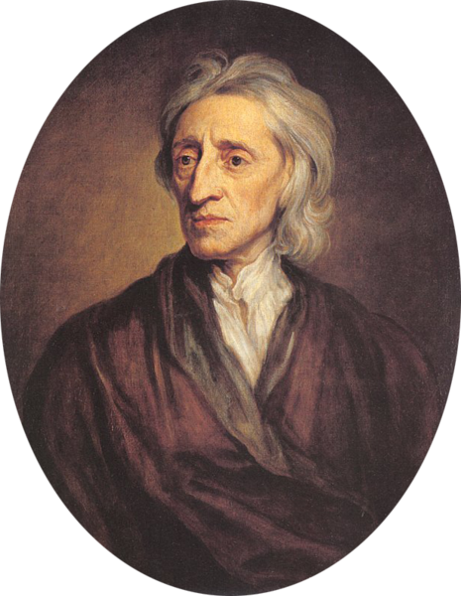
Empiricism
Locke, J. (1689). An essay concerning human understanding. Retrieved from https://ebooks.adelaide.edu.au/l/locke/john/l81u/
Tabula rasa
Understanding the world through the senses
Applying scientific method

Slide 14
Rules of Research
Scientific Method
Formulate a question
Hypothesis
Prediction
Testing
Analysis

Slide 15
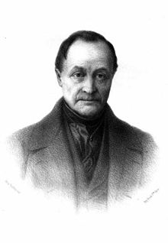
Positivism
Comte, A. (1856). A general view of positivism. Retrieved from https://archive.org/details/ageneralviewpos00comtgoog
Positivism (after Locke)
Sociology (empiricism for the social)

Slide 16
Tenets of Positivism
What is true is that a world exists outside of oneself that can be observed.
What is knowledge is information gathered through the senses.
The logic of positivism is analytical reasoning.
What is valuable is improvement of society.

Slide 17
Philosophy Terminology
What is true is metaphysics
What is knowledge is epistemology
Logic is the rules of dealing with information
Values are axiology

Slide 18
Philosophy of Positivism
Metaphysics: a world exists outside of oneself that can be observed
Epistemology: knowledge is information gathered through the senses
Logic: analytical reasoning
Axiology: improvement of society is valuable

Slide 19
metaphysics
epistemology
What is knowledge based on
What is real
How can thoughts be organized
What is moral
axiology
logic

Slide 20
Read Ornstein and Levine

Slide 21
Realism
Aristotle, Locke, Hume
metaphysics
epistemology
An external material world
Sense experience
Both deductive and inductive
Natural law
axiology
logic

Slide 22
Idealism
Plato, Berkeley, Many Religions
metaphysics
epistemology
Unchanging universal mind
Realizing latent ideas
Deductive from universals
Absolute and eternal
axiology
logic

Slide 23
Pragmatism
Pierce, Dewey, James
metaphysics
epistemology
Interaction of an individual with the world
Constant examination of change
Relative and situational
Inductive
axiology
logic

Slide 24
Existentialism
Kierkegaard, Nietzsche, Sartre
metaphysics
epistemology
Human being as creator of his or her own existence
Total freedom of choice and total responsibility for choices
axiology
logic

Slide 25
Philosophical Research Validity
Idealist: latent truths are revealed
Realist: accuracy in interpretation of the external world
Pragmatist: results are socially valuable
Existential: results help individuals make personal decisions

Slide 26
The Critique of Positivism
You can never know universal truth but you can reject false belief
Popper K. (1959). The logic of scientific discovery. Eastford, CT: Martino Fine Books.
Knowledge changes in paradigm shifts: knowing by consensus
Kuhn, T. (1962). The structure of scientific revolutions. Chicago IL: Chicago University Press.

Slide 27
Post-Positivism
Interpretivism: Knowledge is gained through interpretation
The researcher cannot be separated from the research
Research can serve many purposes
Locating rationality in structures of interpersonal linguistic communication
Habermas, J. (1984). The theory of communicative action. Boston, MA: Beacon Press

Slide 28
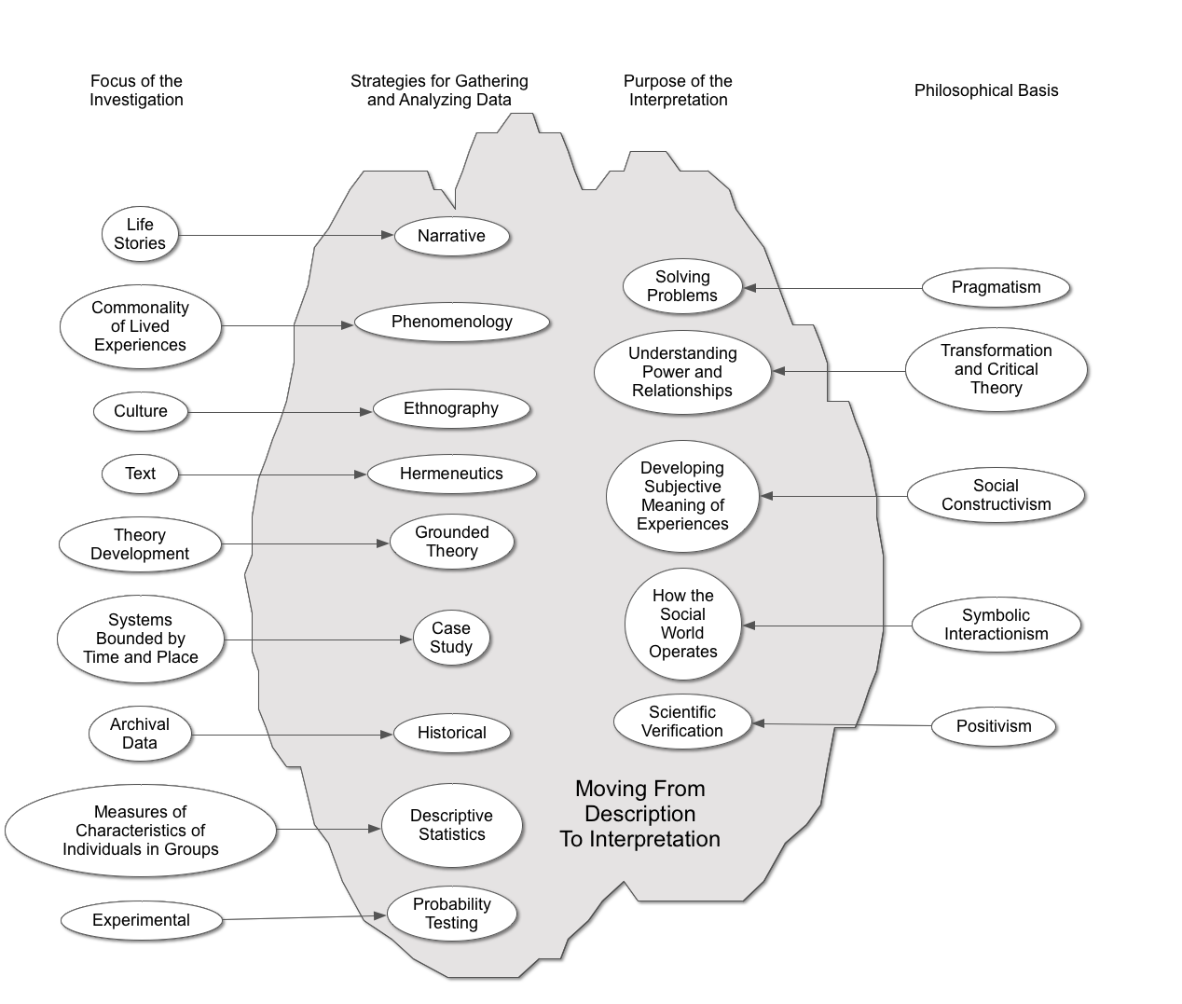

Slide 29
Five Interpretive Frameworks There are more …

Slide 30
Pragmatism Understanding Solutions
The nature of knowledge, language, concepts, meaning, belief, and science are all best viewed in terms of their practical uses and successes.
What is the problem and do the results of study provide a practical course of action?

Slide 31
Transformation and Critical Theory Understanding the Givens
Habermas’ 3 types of knowledge
Control (Clarification of causal relationships)
Positivism
Communication (Establishing understanding among actors)
Interpretivist
Emancipation (Transforming the givens)
Critical Theory

Slide 32
Critical Theory
Habermas identifies cognitive interests in emancipation as implying a third form of knowledge. This knowledge is constructed through a methodology of self-reflection and critical analysis of social conditions impacting one’s life. Its purpose is to identify those conditions which have been defined through uncritically accepted ideology as givens, and to transform those conditions into targets for critique and change.
Peck, 1991

Slide 33
Social Constructivism Understanding Shared Culture
Individuals within groups construct knowledge for one another, collaboratively creating a culture of shared artifacts with shared meanings.
Culture plays a large part in cognitive development.
Vygotsky

Slide 34
Symbolic Interactionism Understanding Human Interaction
We define ourselves through what we believe about how others see us (the looking-glass self).
Meaning is derived from the social interaction that one has with other humans. The need to study human interaction.
These meanings are modified through reflection based on language derived from symbolic understanding.
The world is defined subjectively.

Slide 35
Positivism Understanding What is Most Likely
Scientific verification
Empiricism applied to understanding society
Post positivism believes that truth cannot be known but that probabilities of truth can be established

Slide 36
Qualitative Interpretive Frameworks
Positivism
Social Constructivism
Understanding lived experiences
Pragmatism
Determining best outcomes
Critical Theory
Facilitating emancipation
Interpretivism

Slide 37
Why This Is Important
Positionality
How you gather and analyze data is influenced by what you intend to do with the results.
different purposes—different processes
You have to be careful that you get the right study design for the right purpose.

Slide 38
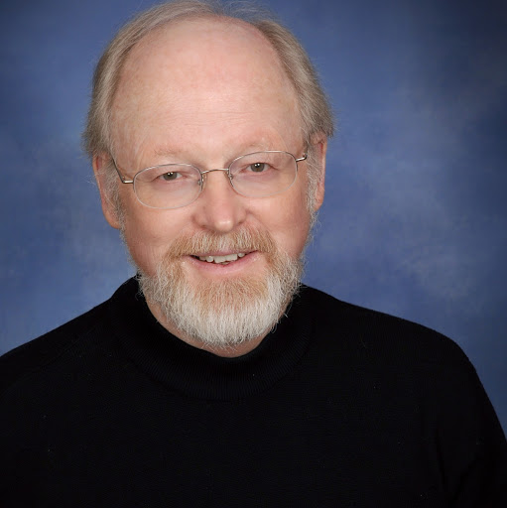
John Creswell
University of Nebraska
Creswell, J. W. (2013). Qualitative inquiry and research design: Choosing among five approaches (3rd ed.). Los Angeles, CA: Sage

Slide 39
Creswell’s 5 Methods
There are many, many more and many variations of each.
There is a continuum of the degree to which specific procedures should be used with each method. Creswell tends to be in the middle.

Slide 40
Narrative Research
Interpretive framework
Usually symbolic interactionism
Purpose
Examining experience through personal stories
Data
The stories from one or a few respondents
Interviews but could include other forms
Analysis
Usually analyzed thematically (restorying)

Slide 41
Phenomenological Research
Interpretive framework
Usually social constructivist
Purpose
Establishing the shared essence of a phenomenon through lived experience
Data
Exploration with a small group
Interviews
Analysis
Usually analyzed thematically (coding)
Bracketing (removing influences of prior experience)

Slide 42
Grounded Theory Research
Interpretive framework
Usually social constructivist
Purpose
Generation of a unified theoretical explanation
Data
Exploration of processes over time
All possible sources
Analysis
Coding categories
Constant comparative

Slide 43
Ethnographic Research
Interpretive framework
Usually social constructivist
Purpose
Generation of shared patterns within a group (culture)
Data
Examines social organization through fieldwork
All possible sources
Gathering of direct quotations
Analysis
Usually analyzed thematically (coding)

Slide 44
Case Study Research
Interpretive framework
Usually social constructivist
Purpose
Generation of assertions about a case
Data
Examines an individual or a small group usually
All possible sources
Analysis
A case description

Slide 45
How about pragmatism and critical theory?
Narrative
Phenomenological
Grounded theory
Ethnographic
Case study

Slide 46
A few other thoughts …
Hermeneutics (analysis of texts)
Hermeneutical circles
Descriptive statistics
Summaries of characteristics of individuals in groups
Historical

Slide 48
Creswell’s General Thoughts About Qualitative Research
Time
Complex data analysis
Lots of writing
Methods are not necessarily established for each kind of research

Slide 49
Creswell’s Process
Think about assumptions
Start reading the literature
Gather data from a variety of sources
Analyze
Validate
Report in an engaging style

